Slide 1
Project Presentation on
C-Programming
Project Title – Flying Croc
An Interactive GaMe
Members :
Satish Pant
Pranjal Dhakal
Prateek Raj Joshi

Slide 2
So what is Flying Croc ???
It is a game prepared in C- programming language along with SDL libraries .
Logic part of the program is managed by C codes
Where as the graphics part is handled by SDL codes
So, What is SDL really ???
Simple DirectMedia Layer(SDL) is a cross-platform multimedia library designed to provide low level access to audio, keyboard, mouse, joystick, 3D hardware via OpenGL, and 2D video framebuffer.

Slide 3
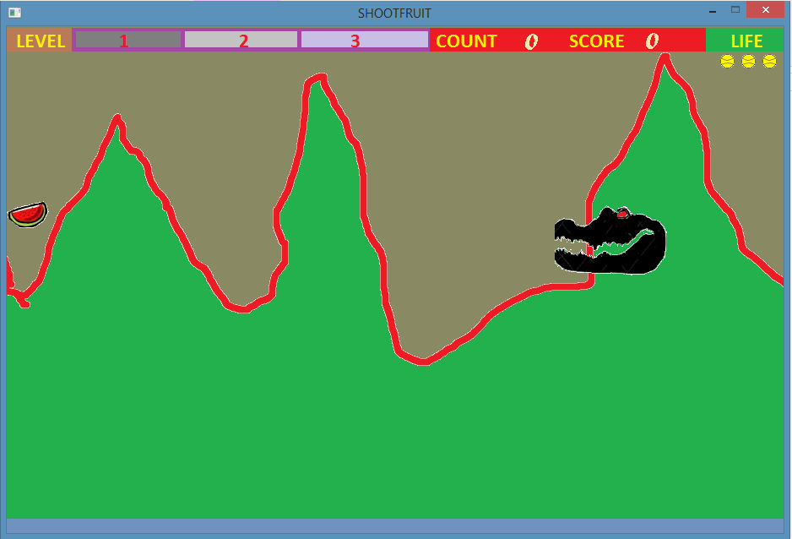
What does it look like ???
In this game , a crocodile head flies through different obstacles eating fruits.
To open the game the game’s executable file has to be opened.
The game runs in wide 920X 600 screen with 32-bit color depth.
The game runs with a energizing background music to make the game more exciting.
This is the first screen seen after “Start Game” option in Game Menu is pressed.

Slide 4
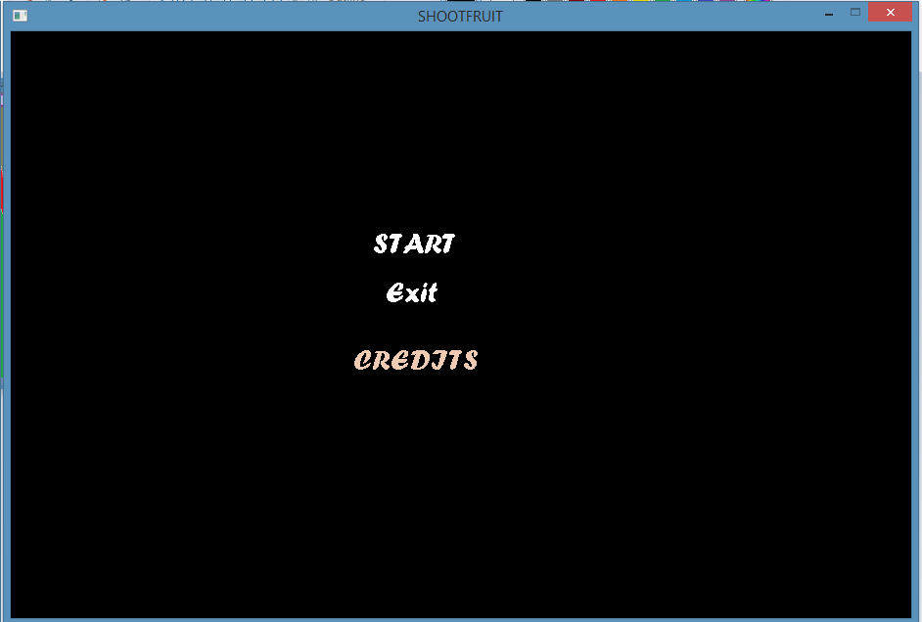

Features of the Game…….
After opening the executable file, this Game Menu Screen is seen.
And this music runs through out the game.

Slide 5
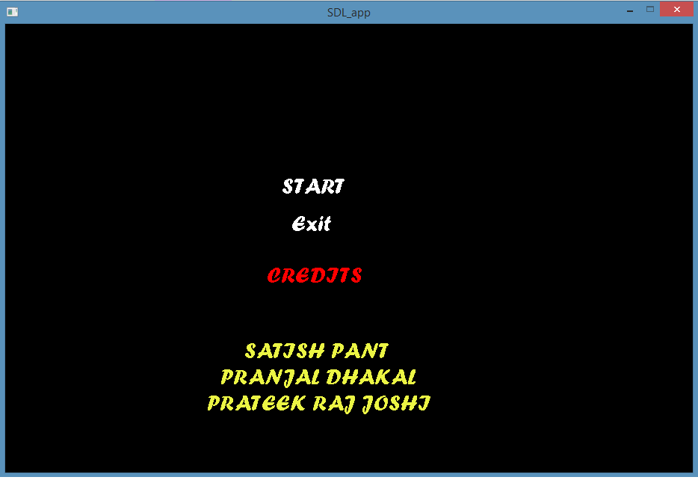
Features of the Game…….
There are three menu items; Start, Exit & Credits.

Slide 6
Features of the Game…….
Displays number of lives remaining.
Score bar:
Displays number of fruits eaten
i.e., Score.
The background is a scrollable background which gives the feeling that the Croc is actually moving forward.
It displays the score graphically with a bar .
After pressing Start , this screen is seen.
It is the main “PLAYER” of the game called Croc, which flies with user command (‘UP’ key) passing through different obstacles

Slide 7
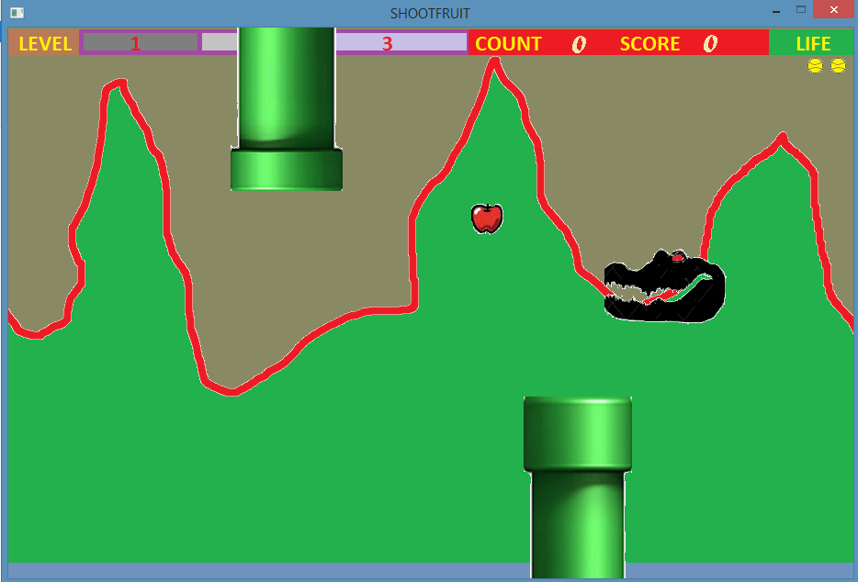
Features in this Game…….
This is food for Croc. Eating this will increase the Score.
When the Croc collides with any of these two obstacle then the life decreases and ultimately results in ‘Game Over’.
Obstacles will appear with random height and order. After collision a sound clip is played .

Slide 8
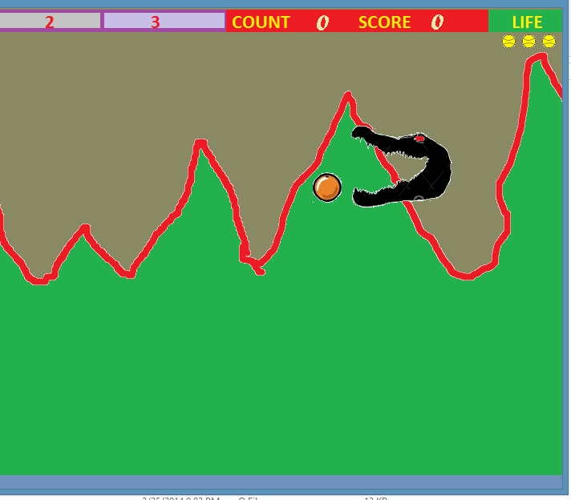

Features of the Game ……
When the Croc comes near the fruit its mouth also opens and again shuts after passing it.
There are 8 different food for the Croc which randomly appear in the screen from the left most side.
Each time the Croc eats the food score increases and a sound clip is produced.

Slide 9
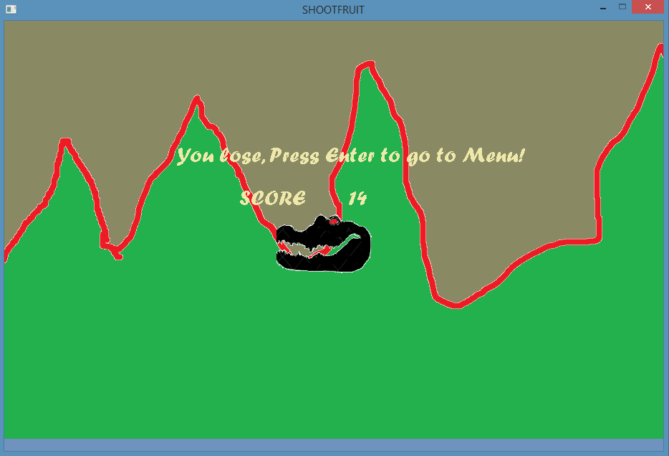
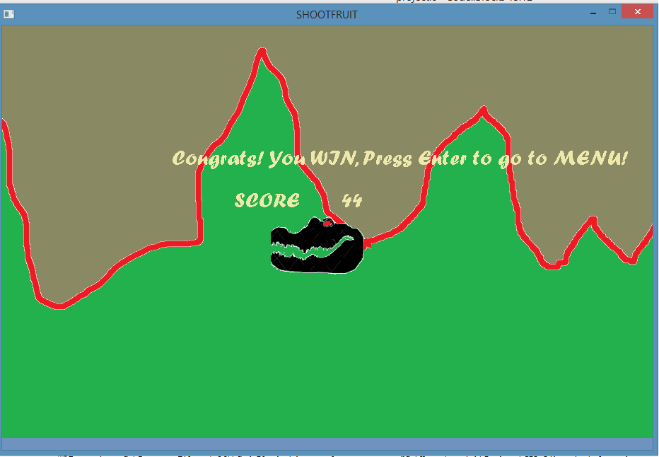
Features of the Game ……
If all lives are lost before completing level bar then this message pops out in the screen.
Also a sound indicating game over is played in the game.
If all the food and obstacles are cleared then the following message pops out in the screen and a sound clip is played indicating successful completion of the game.
If you want to play again you can press Enter to go to main Menu and Click start otherwise click exit.
Game menu can also be displayed during game play bypausing the game by pressing Escape key.

Slide 10
What we learnt from this project?
From this project , we learnt about use of graphics in c-programming. We didn’t know much about graphics(game) programming or programming using SDL before.
This project helped us to develop confidence in doing projects like this. In our next project in the future, we can use the ideas generated from doing this project, and make the project much advanced and efficient.
This project played key role in making us understand the spirit of team work, division of tasks, communicating & understanding with each other which is very essential to us in the future.

Slide 11
Conclusion

